Slide 1
Credit Card Application Management System Developed in PHP & MySQL
Username: johndeo12
Password: Test@123
Or Register a new Sub-Admin.
CC Application No :
Application No: 567944808
Or Apply for a new credit card.
Credential for admin panel :
Username: admin
Password: Test@123
Credential for Sub-Admin panel :
Username: johndeo12
Password: Test@123
Or Register a new Sub-Admin.

Slide 2
Abstract
Credit Card Application Management System contains data and information of credit card holder who apply for credit card online. The main purpose of CCAMS is to systematically record, store and update the details of admin/sub-admin and also manage the credit card application.
This projects helps to those people who apply credit card online without wasting a time and also check the application status by their name/mobile number/application number.

Slide 3
Purpose of the Project
The purpose of developing Credit Card Application Management System is to apply credit card online without wasting a time. Another purpose for developing this application is to generate the report automatically.
Scope of the Project
Credit Card Application Management System is developed as a web application and it will work over web to apply credit card online.

Slide 4
Introduction
Credit Card Application Management System is a web-based technology the main purpose this project is to provide all online credit card application management. User can apply credit card online and check the application status by using his/her name /mobile number/application number.
In Credit Card Application Management System we use PHP and MySQL database. This is the project which keeps records of of admin/subadmin and also manage the credit card application. Credit Card Application Management System has three module i.e. admin, Sub-Admins and users.

Slide 5
Project Modules
In Credit card Application Management System we used PHP and MySQL database. This project has two modules i.e., admin, Sub-Admin and user.
User Module
User can visit the website.
User apply for credit card online.
Users can check the application status by using application number/name/mobile number.

Slide 6
Admin Module
Dashboard: In this section admin can briefly view total number of Subadmins and total number of new application, accepted application and rejected application.
Subadmins: In this section, admin can manage the Sub-Admins (add/update,Delete).
CC Application: In this section, admin can manage the credit card application and change the status of application according to current scenario.
Report: In this section, two reports are available.
B/w Dates Report: Admin can view number of credit card application received in the particular periods.
Search Report: admin can search Credit Card Application by using Name/Email/Mobile Number/Application Number.
Pages: In this Section, Admin can manage the content of about us and contact us page.
Account Settings:
Profile: In this section admin can update his/her profile.
Change Password: In this section admin can change his/her own passwords
Logout: Through this button admin can logout.
Forgot Password: In this section, admin can reset his/her password by using registered email id and contact number.

Slide 7
Sub-admin Module
Sub-Admin and Admin features are the same except Sub-Admin creation. Sub-Admin can’t create the Sub-Admins.
Note: In this project MD5 encryption method used.

Slide 8
Requirement Specification
Hardware Configuration:
Client Side
Server Side
RAM | 512 MB
Hard Disk | 10GB
Processor | 1.0 GHz
RAM | 1 GB
Hard Disk | 20GB
Processor | 2.0GHz

Slide 9
Continue.....
Software Requirement:
Client Side
Server Side
Web Browser | Google Chrome or any compatible browser
Operating System | Windows or any equivalent OS
Web Server | APACHE
Server side Language | PHP5.6 or above version
Database Server | MySQL
Web Browser | Google Chrome or any compatible browser
Operating System | Windows or any equivalent OS

Slide 10
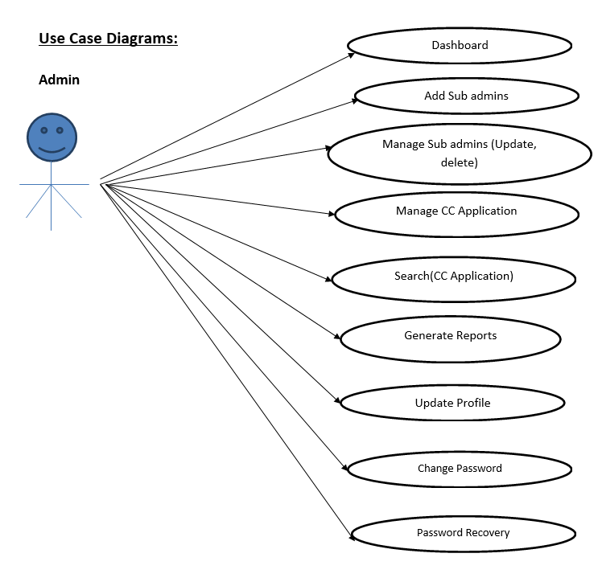
Use Case Diagram
Notes:
USECASE DIAGRAM: A Use case is a description of set of sequence of actions. Graphically it is rendered as an ellipse with solid line including only its name. Use case diagram is a behavioral diagram that shows a set of use cases and actors and their relationship. It is an association between the use cases and actors. An actor represents a real-world object. Primary Actor – Sender, Secondary Actor Receiver.

Slide 11
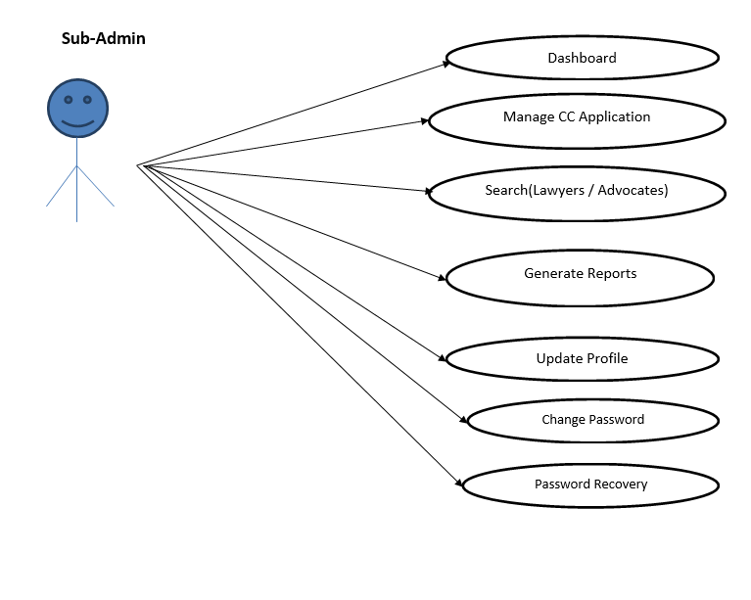
Continue…

Slide 12
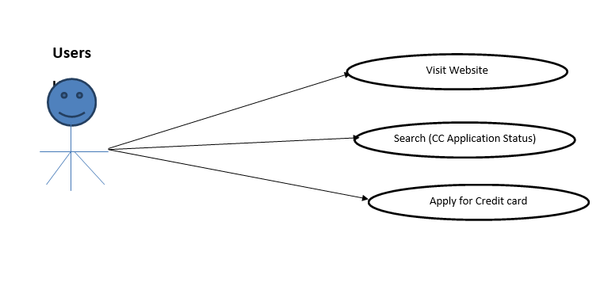
Continue…

Slide 13
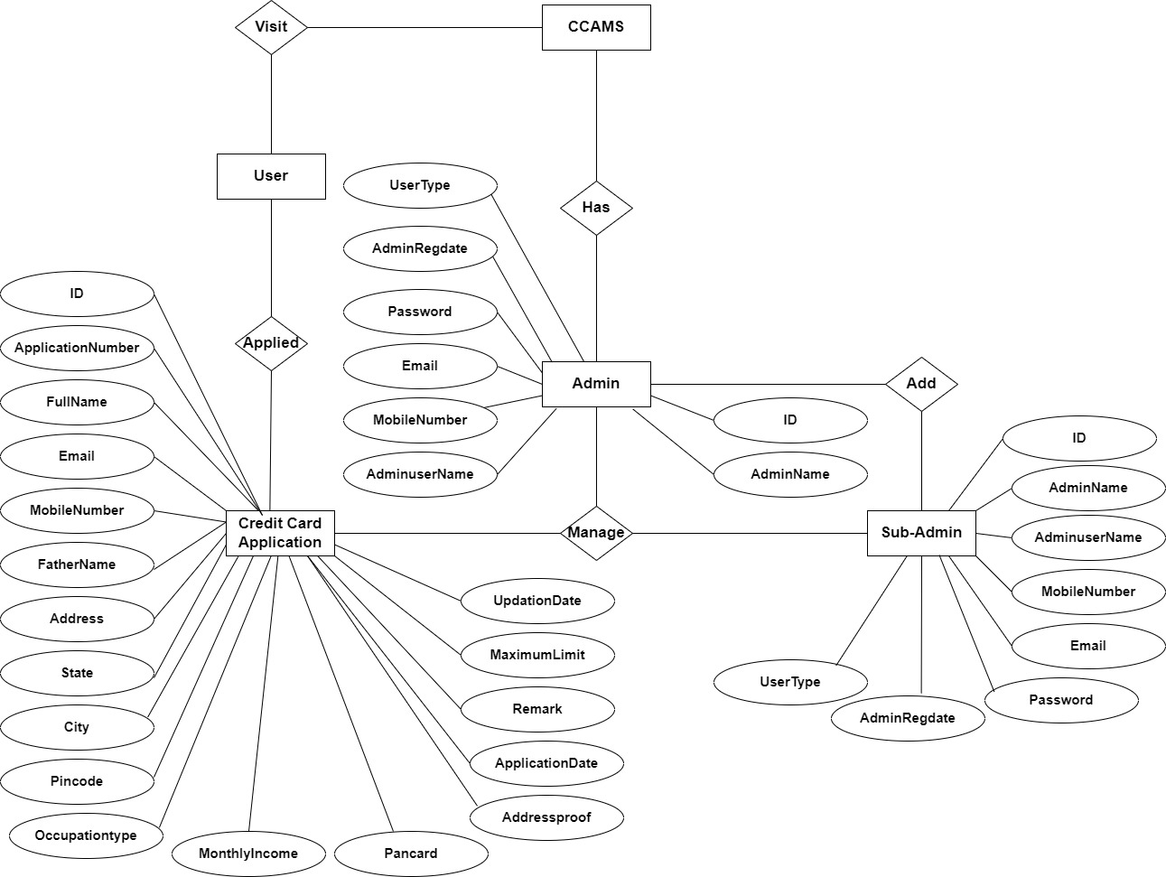
ER Diagram

Slide 14
Dataflow Diagrams (DFDs)
A Data Flow Diagram (DFD) is a traditional visual representation of the information flows within a system. A neat and clear DFD can depict the right amount of the system requirement graphically. It can be manual, automated, or a combination of both.
It shows how data enters and leaves the system, what changes the information, and where data is stored.
The objective of a DFD is to show the scope and boundaries of a system as a whole. It may be used as a communication tool between a system analyst and any person who plays a part in the order that acts as a starting point for redesigning a system. The DFD is also called as a data flow graph or bubble chart.

Slide 15
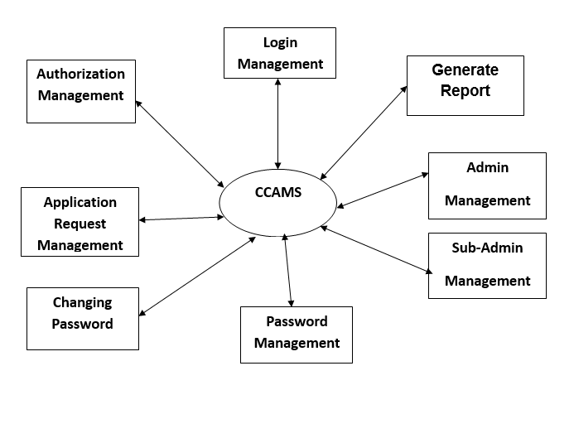
Zero level

Slide 16
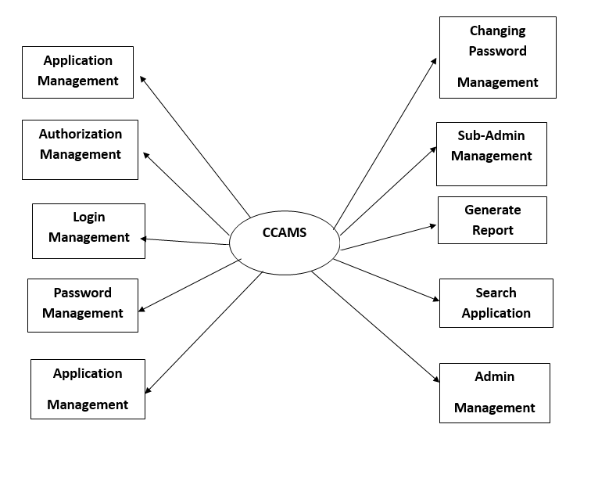
First level

Slide 17
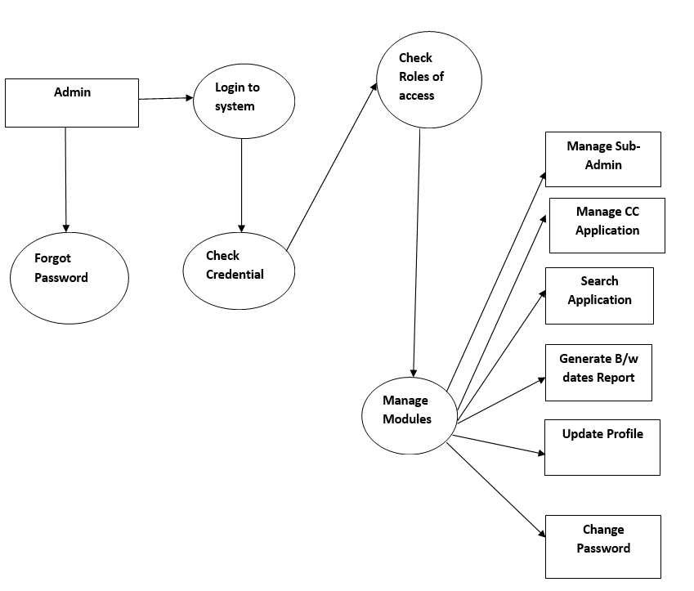
Second Level

Slide 18
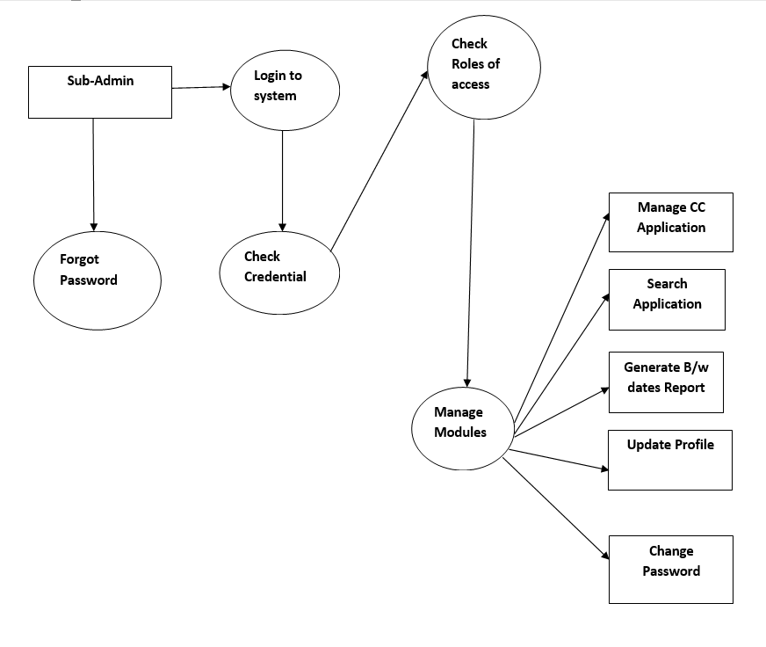

Slide 19
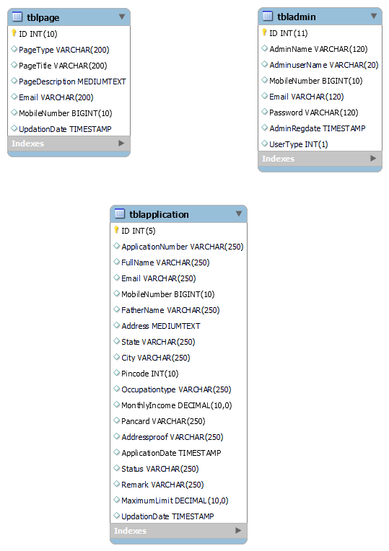
Class Diagram
Notes:
The class diagram shows a set of classes, interfaces, collaborations and their relationships.

Slide 20
Implementation and System Testing
After all phase have been perfectly done, the system will be implemented to the server and the system can be used.
System Testing
The goal of the system testing process was to determine all faults in our project .The program was subjected to a set of test inputs and many explanations were made and based on these explanations it will be decided whether the program behaves as expected or not. Our Project went through two levels of testing
Unit testing
Integration testing

Slide 21
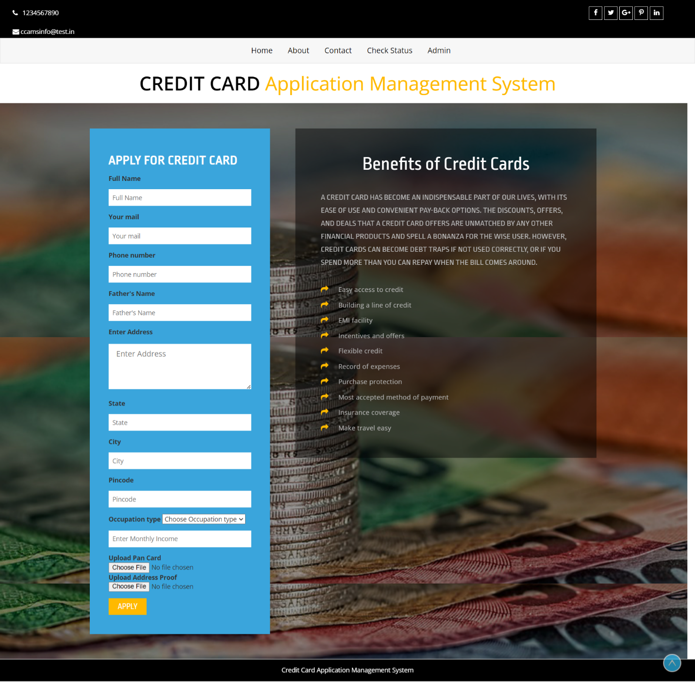
Project Screens

Slide 22
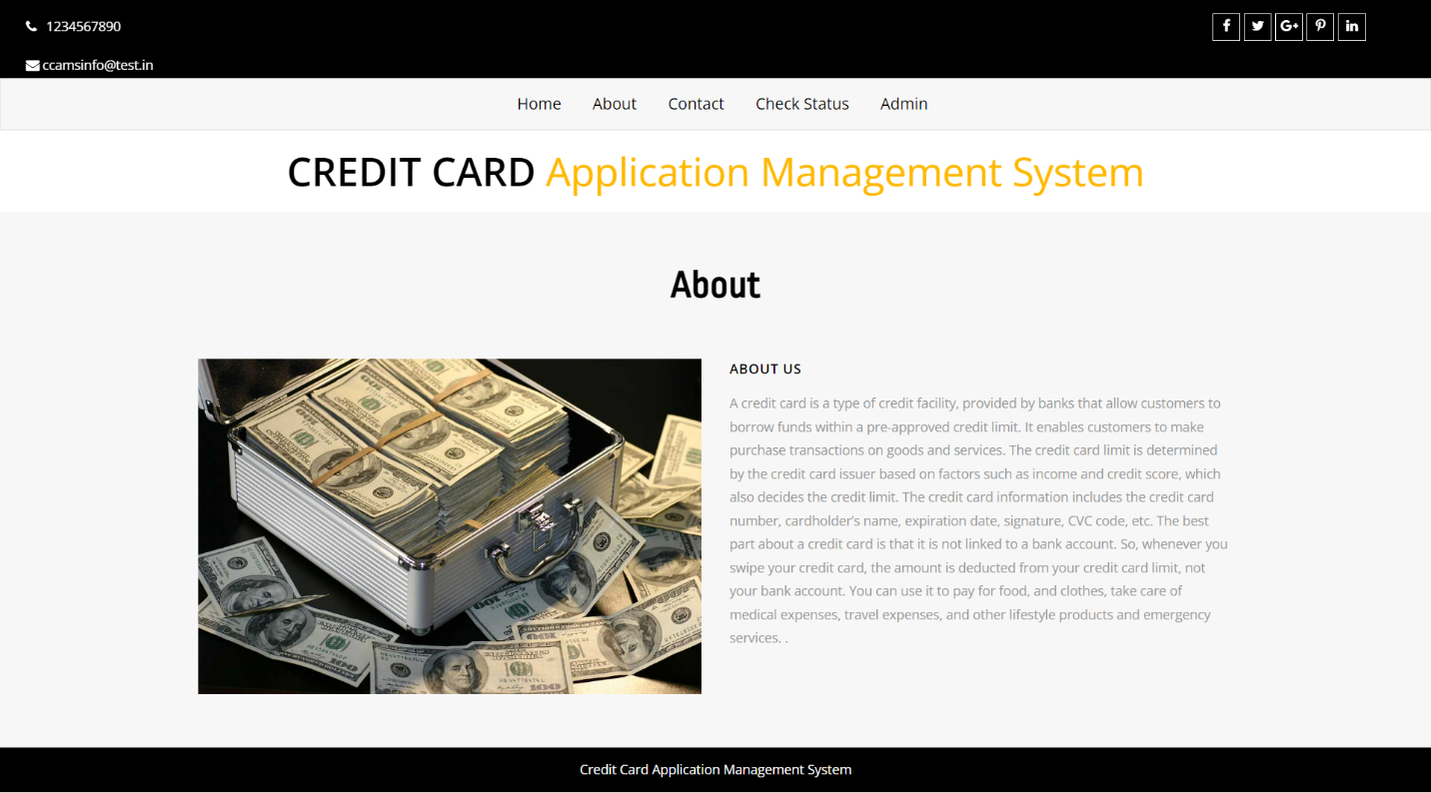
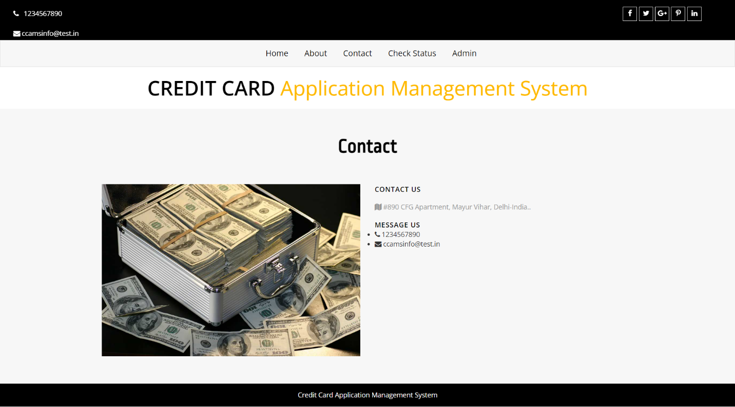

Slide 23
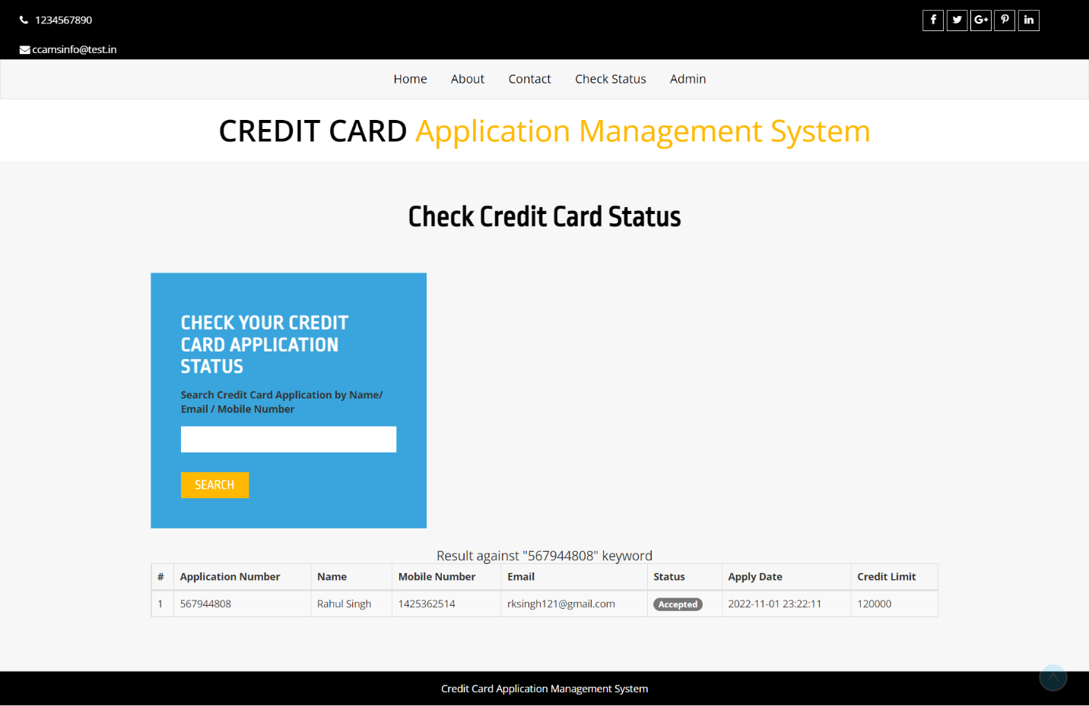
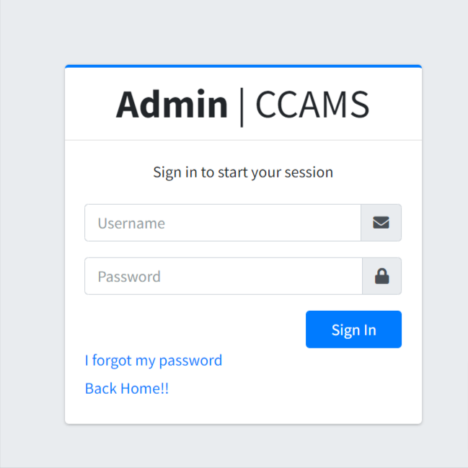

Slide 24
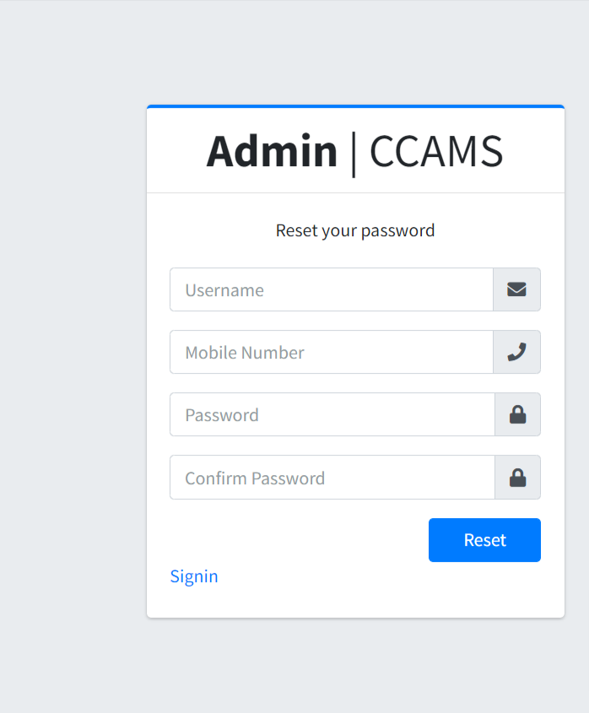
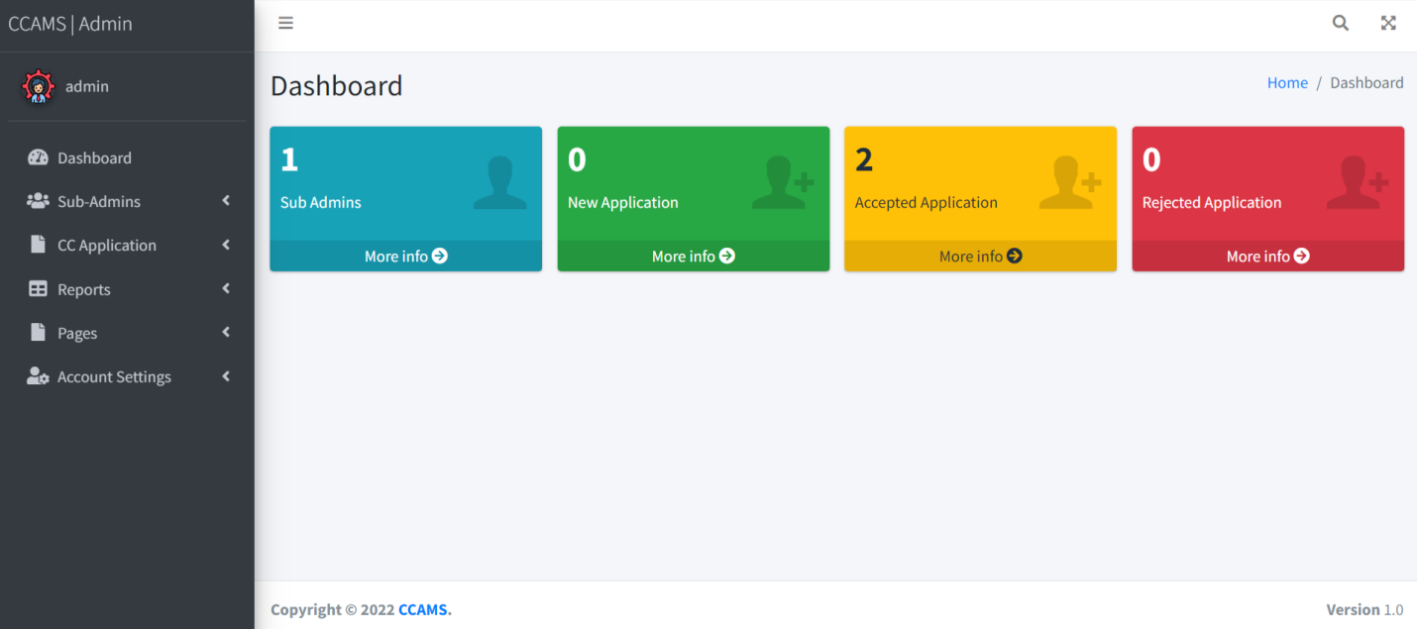

Slide 25
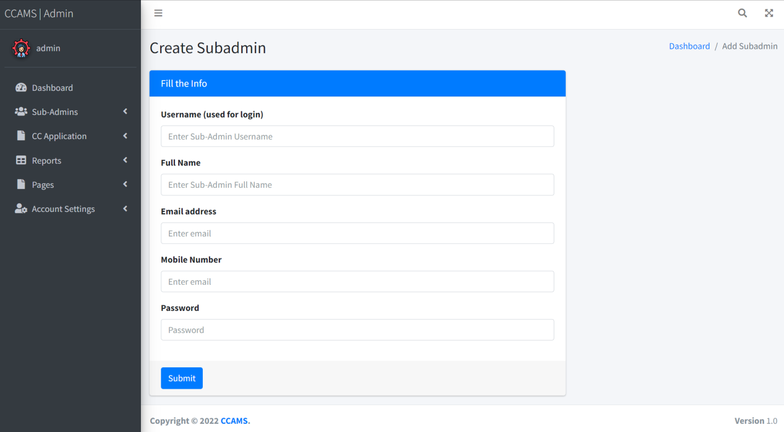
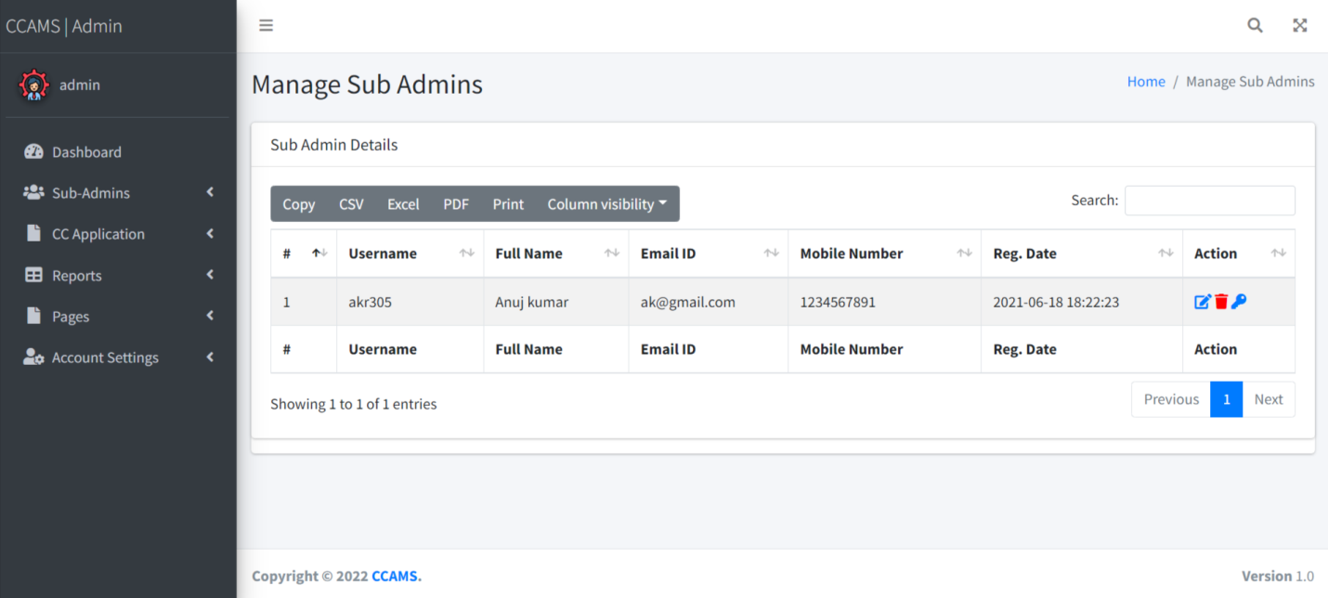

Slide 26
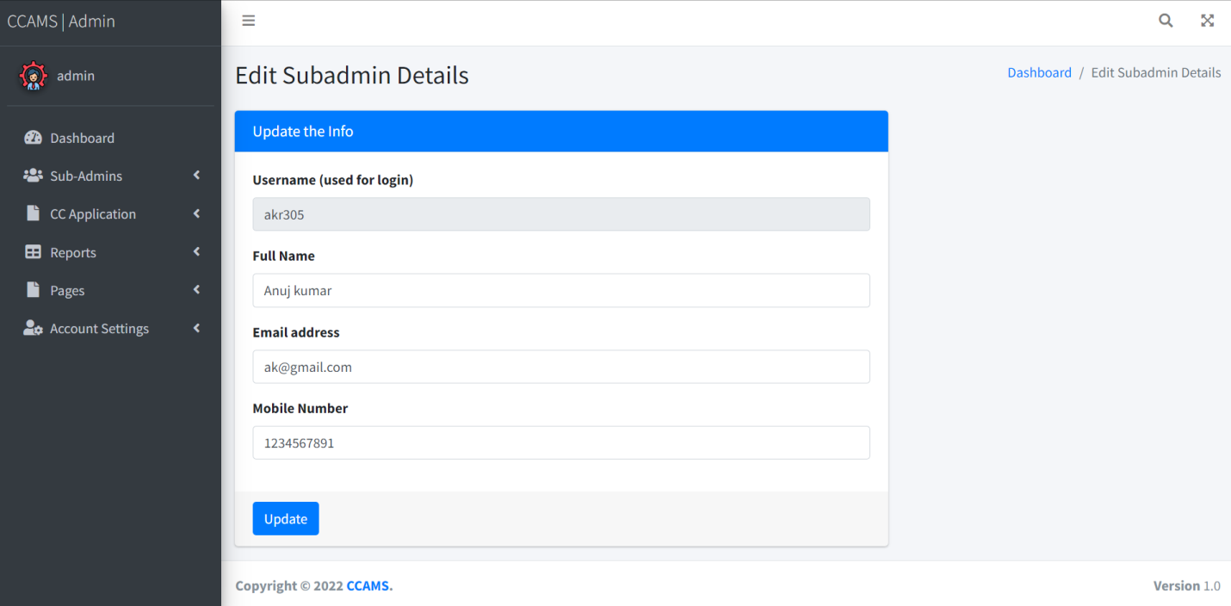
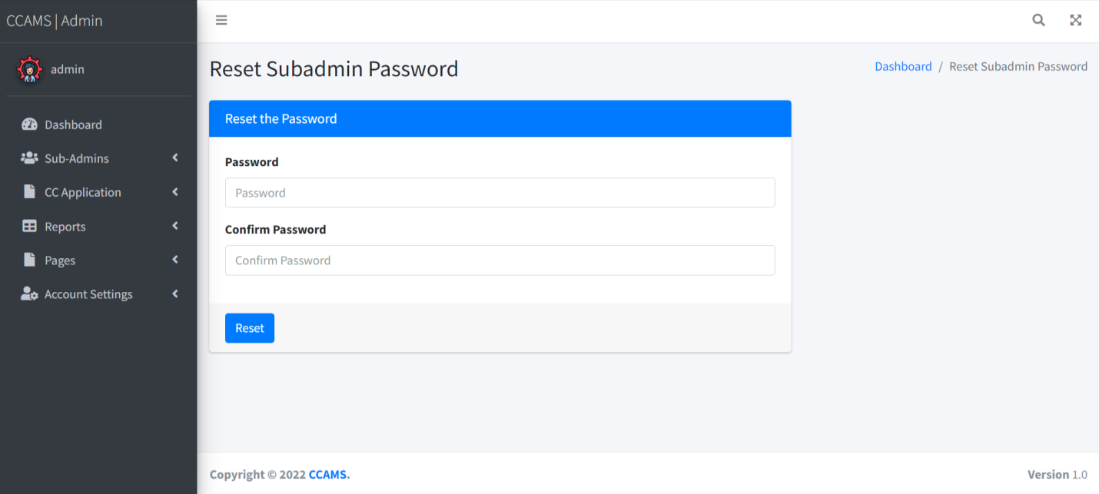

Slide 27
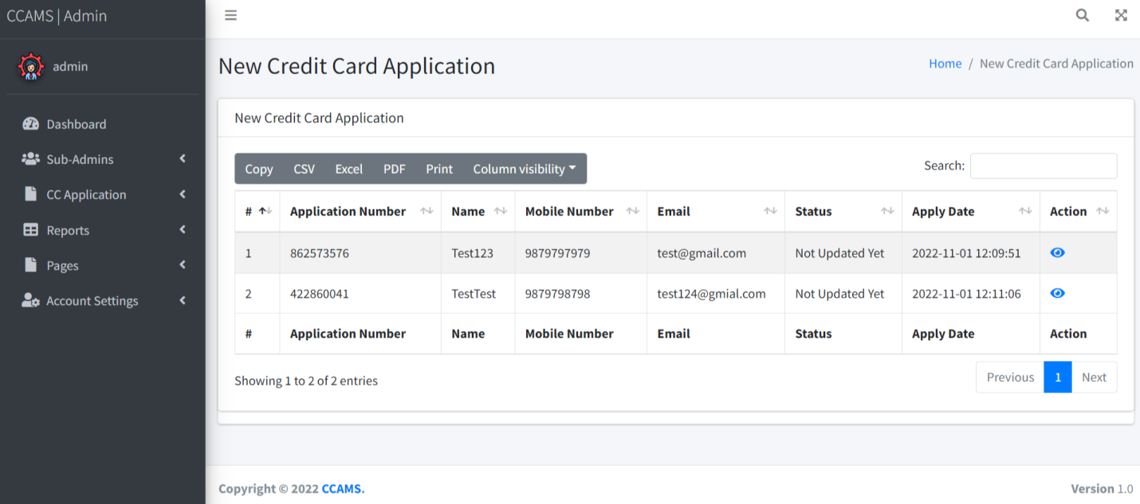
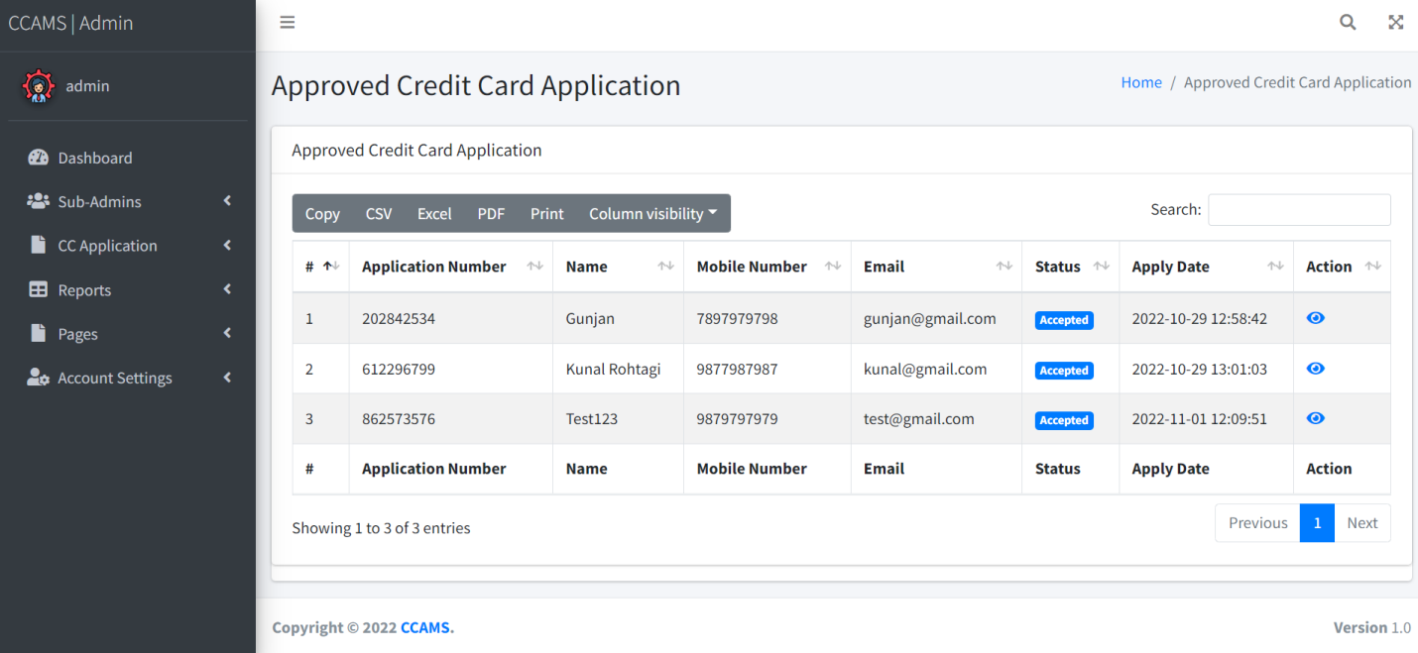

Slide 28
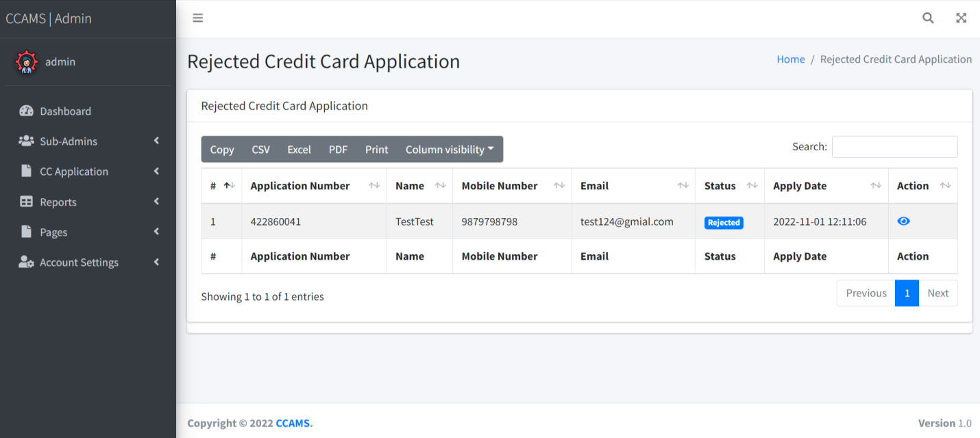
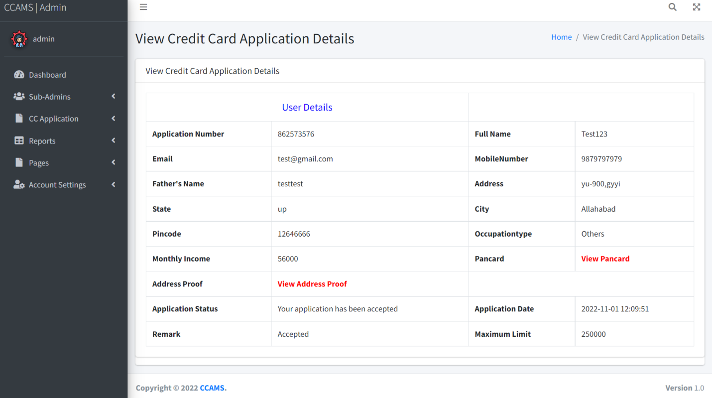

Slide 29
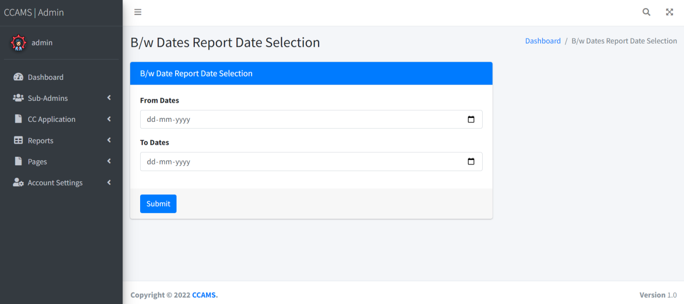
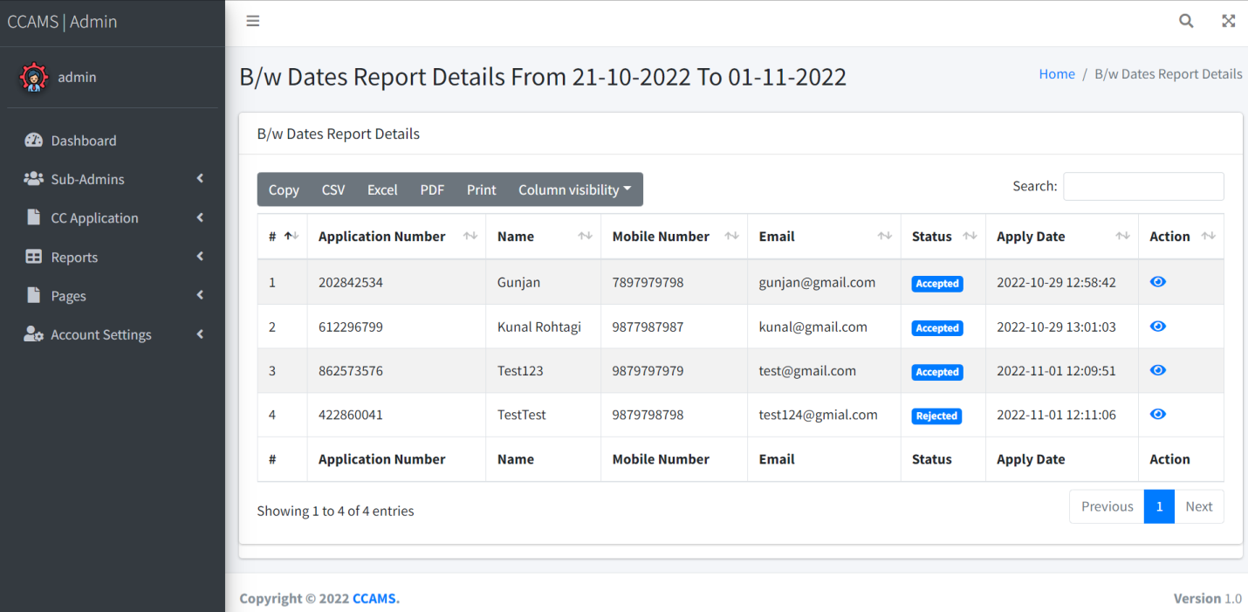

Slide 30
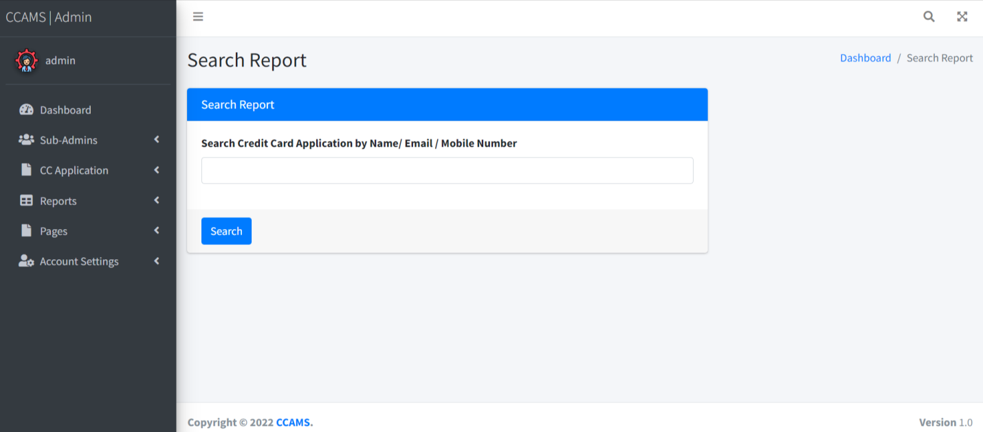
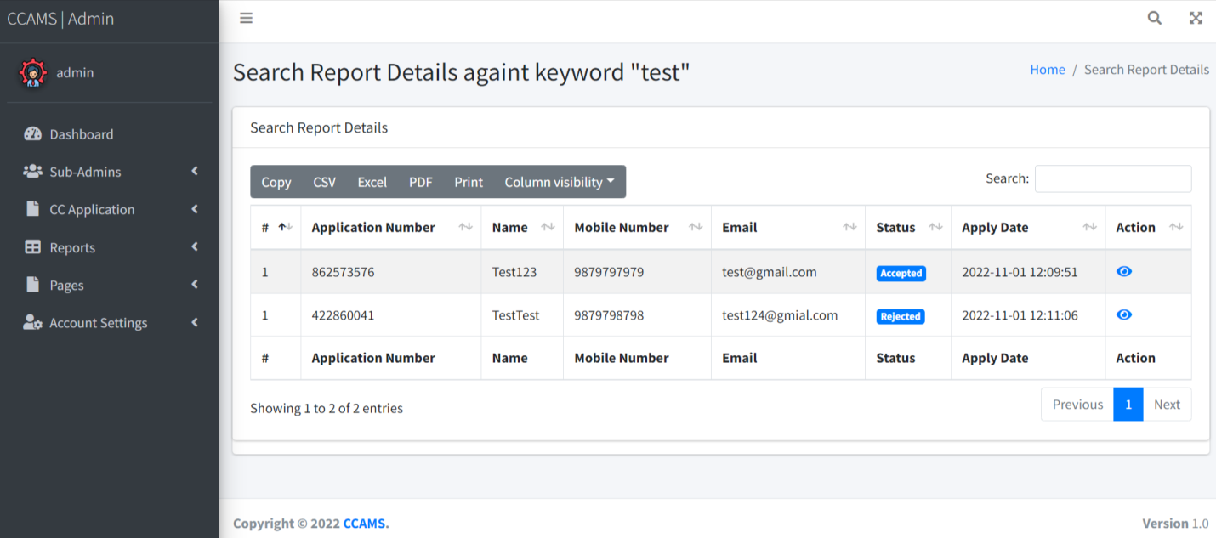

Slide 31
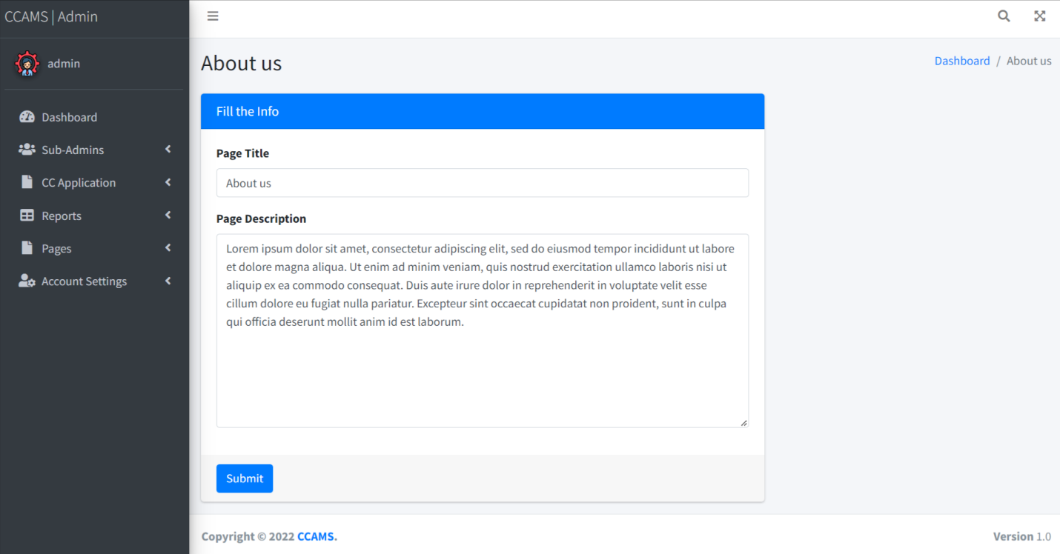
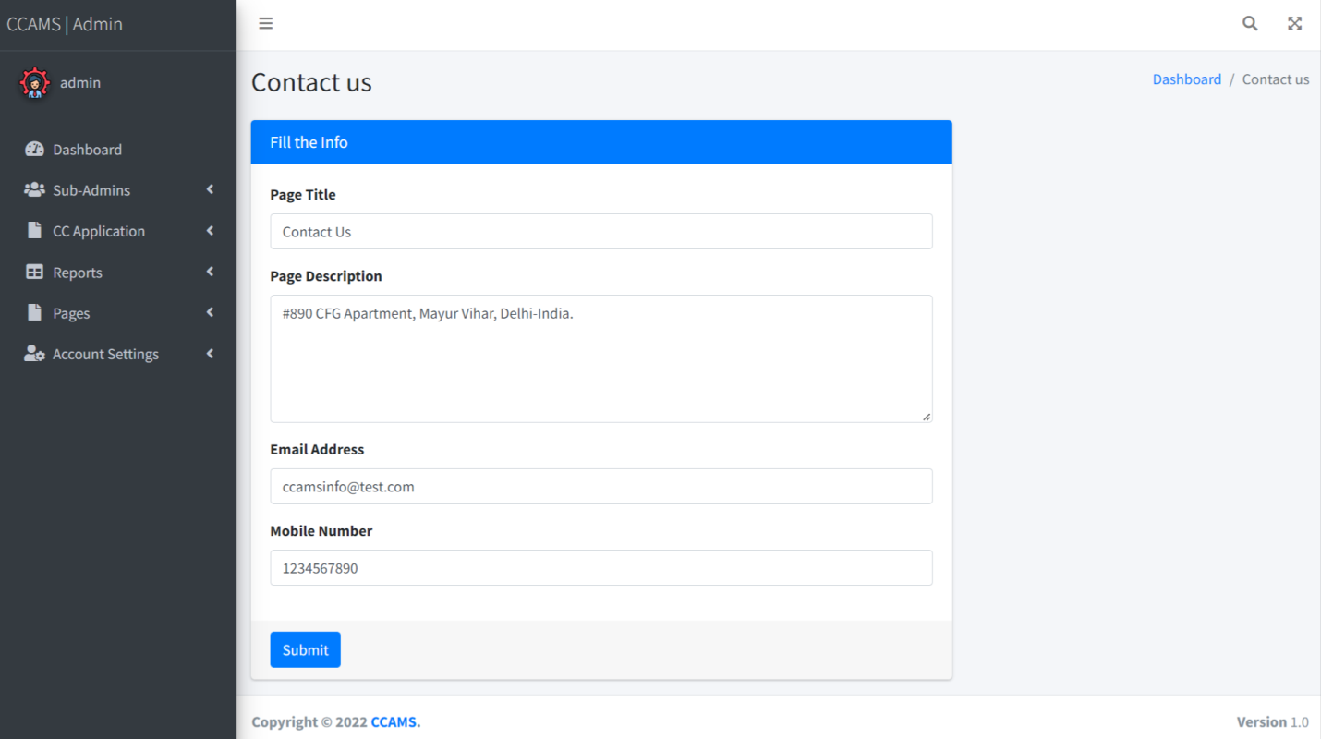

Slide 32
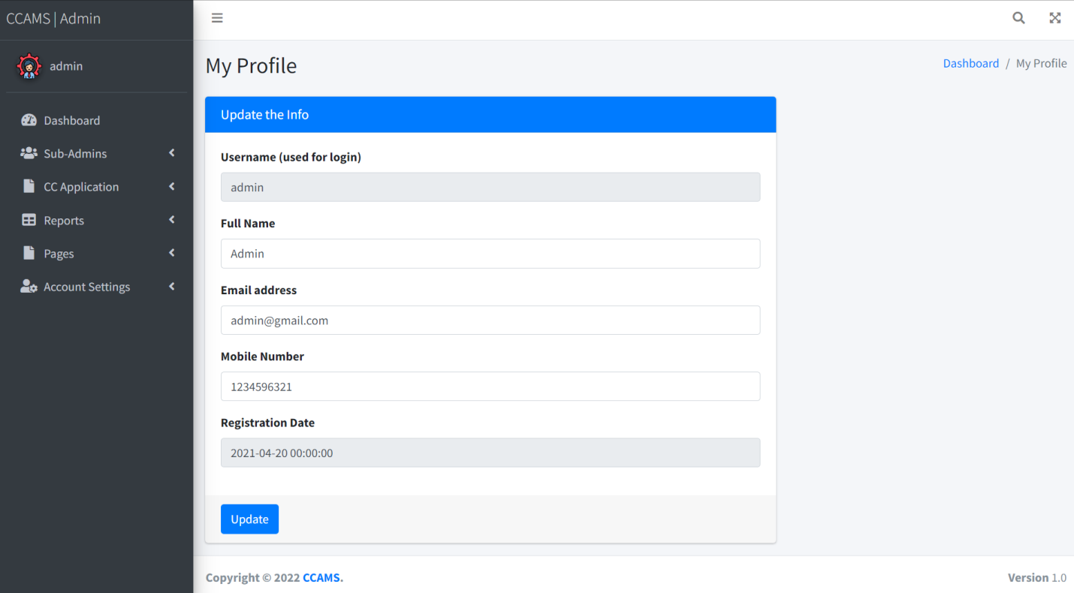
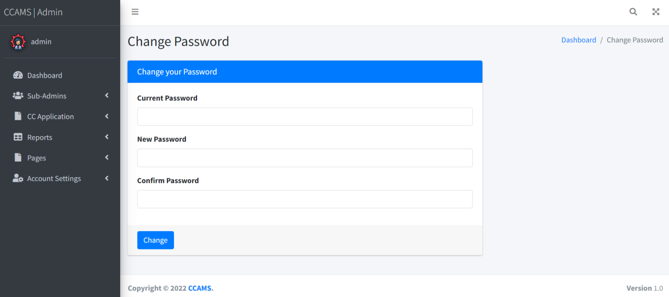

Slide 33
Conclusion
This Application provides an online version of Credit Card Application Management System which will benefit the bank firm who want to maintain records of credit card holder and also help to customer to apply credit card online without wasting a time and apply with their convenience.
It makes entire process online and can generate reports. The Application was designed in such a way that future changes can be done easily. The following conclusions can be deduced from the development of the project.
Automation of the entire system improves the productivity.
It provides a friendly graphical user interface which proves to be better when compared to the existing system.
It gives appropriate access to the authorized users depending on their permissions.
It effectively overcomes the delay in communications.
Updating of information becomes so easier.
System security, data security and reliability are the striking features.
The System has adequate scope for modification in future if it is necessary.
.

Slide 34
References
For PHP
https://www.w3schools.com/php/default.asp
https://www.sitepoint.com/php/
https://www.php.net/
For MySQL
https://www.mysql.com/
http://www.mysqltutorial.org
For XAMPP
https://www.apachefriends.org/download.html

Slide 35
Thank You

